Slide 1
Academic Literacies: A long view
Lucia Thesen
University of Cape Town

Slide 2
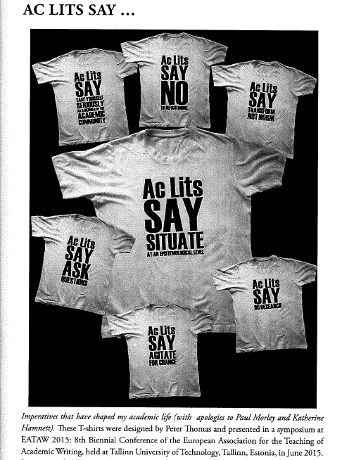
Ac Lits say…
Situate at an epistemological level
Say NO to the deficit discourse
Transform not norm
Do research
Agitate for change
Ask questions
Take yourself seriously as a member of an academic community

Slide 3

CHED
EDUs across faculties
Two central units
  Language Development Group
    Undergraduate AcLits teaching
    Postgraduate AcLits teaching
    Writing Centre and Hubs
  Numeracy Centre

Slide 4
1987: English for Academic Purposes: discourse of (linguistic) disadvantage
Borrowed curriculum from British Council ideas – English as a post-colonial export
Changed the content, locally relevant
Struggle for accreditation, compulsion
Based on a construction of black students as disadvantaged

Slide 6
2003: The diversity discourse

Slide 7
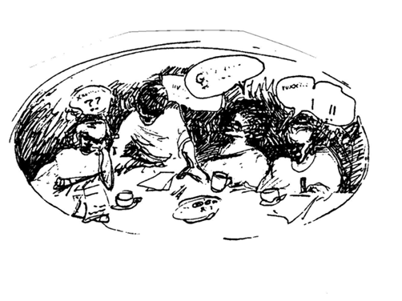
2017: research identity spaces

Slide 8


Slide 9


Slide 10
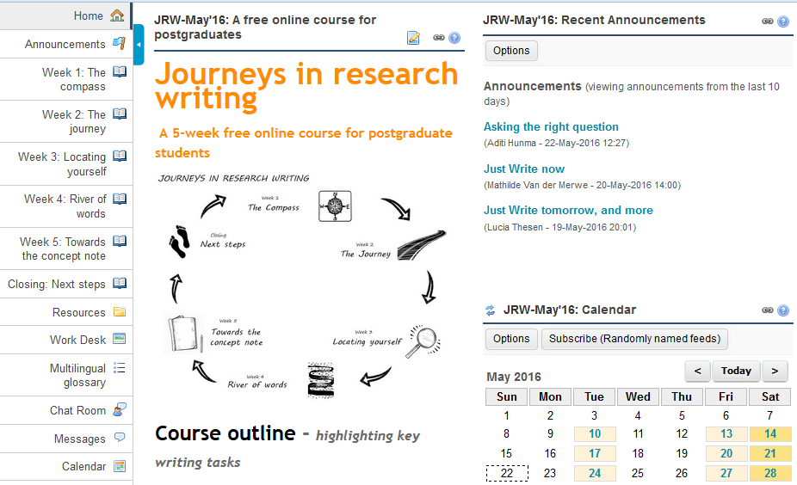
Online

Slide 11
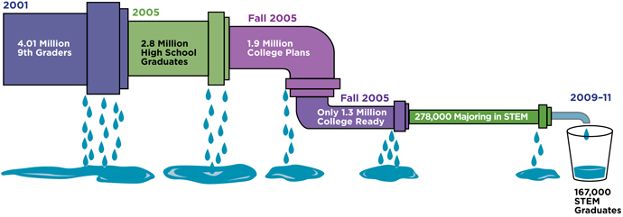

The pipeline

Slide 12
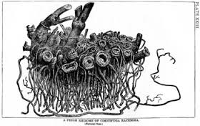
Our institutions as precarious networks
http://thinkingenterprise.blogspot.fr/2011/04/rhizome-on-dilemmas-in-enterprise.html

Slide 13
Ac Lits say…
Situate at an epistemological level
Say NO to the deficit discourse
Transform not norm
Do research
Agitate for change
Ask questions
Take yourself seriously as a member of an academic community

